Slide 1
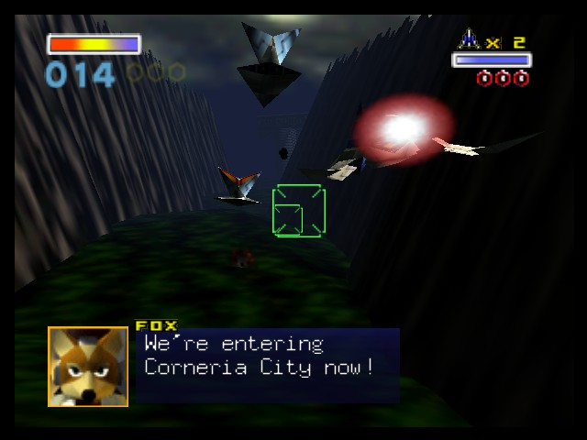
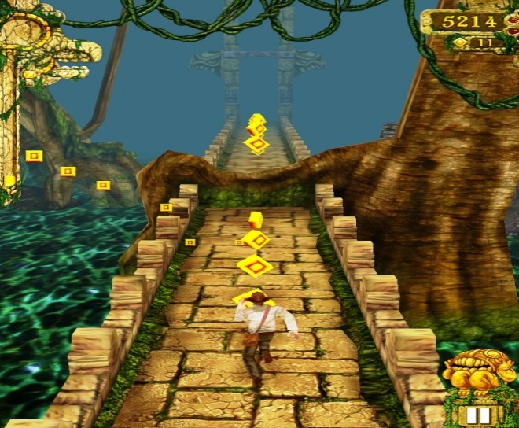
Death-rone
Notes:
I start off the presentation by giving a quick introduction about myself, and proceed to inform the potential investors about my game, Death-rone (Death Run/De-throne)

Slide 2
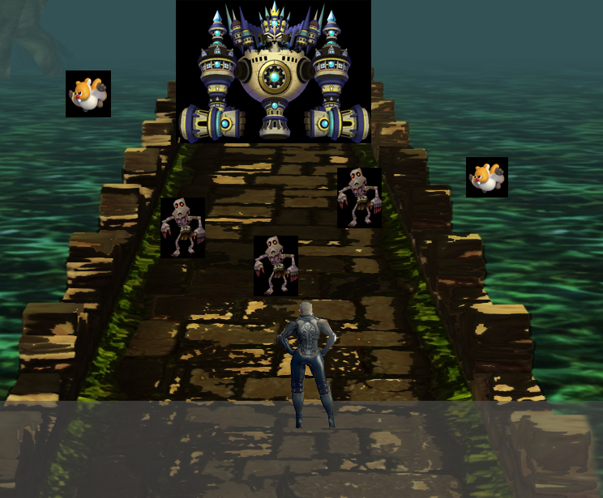
What is it?
Endless runner that has action combat mechanics.
Simple movement and combat controls, intended to be played with one hand on mobile devices.
Linear progression with boss battles.
Notes:
I explain what the project is going to consist of, whilst giving the basic idea to investors what the basic fundamentals are which could potentially outshine competition. I would let the investors know that I will go into further detail regarding the concept art.

Slide 3
Why Create this?
Lack of action combat on-rail games on mobile.
Simple to play with one hand.
Mechanics intended to be simple and engaging.
Notes:
I explain briefly about how I wish to create a game that is easy to play with one hand, feels fast and fluid and has linear style progression with combat mechanics. The current lack of true-action on-rail mobile games on mobile is lacking, and action games on mobile generally require a long and steep learning curve that some mobile gamers refuse to learn. ( For Reference, http://tinyurl.com/o3ywx2b)

Slide 4
Target Market?
People who enjoy linear gameplay action.
People who enjoy non-convoluted stories.
Gamers on the go.
Notes:
I would give a brief explanation on the games intended target market. Generally people who enjoy linear gameplay with simple storylines, as well as gamers on the go. I give a quick reasoning behind this, saying that mobile games can achieve compelling storylines, but a major emphasis on addictive gameplay and fun factor works just as well. (reference from http://preview.tinyurl.com/pnwow5s)

Slide 5
What unfair advantage is there?
Simple control scheme for a combat-heavy game.
Levels progress on-rail style, with end boss battle.
Players given a choice to progress in any order.
Notes:
I further emphasize that the gameplay is a crucial part to the game, convenience to play it coming to a close second. I would point out that having a simple gameplay mechanic and learning curve whilst showing off appealing in game aesthetics and control is a factor that can influence your game’s popularity and longetiviity.

Slide 6
Concept Art
Final Boss of the stage
Combination of flying and ground enemies
Player swipes area to cut, or tap to fire projectile, destroying the enemies.
Grey Area: Player movement Area (left/right/jump)
Player has 3 lives, life count determined by current player character’s aesthetics.
Notes:
For this concept slide, I would go into detail and point out each specific element of the concept screenshot shown earlier, primarily what each pointed object and element on the screenshot points towards.

Slide 7
What Risks would be involved?
Overcrowded mobile games market.
Potential copyright from competition.
Notes:
I would keep the risks as simple and relevant as possible to a project like this. A big risk would be the potential copyright infringement from the competition (Shadow Run) in the next slide.

Slide 8
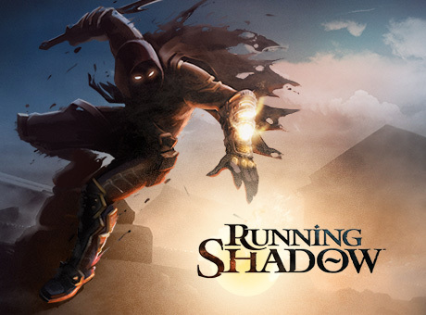
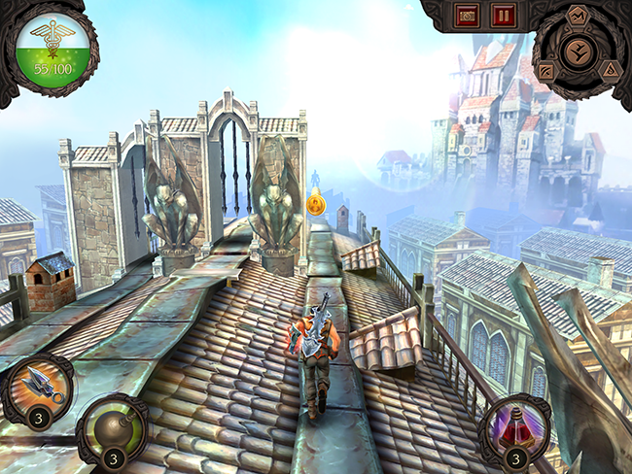
Potential competition?
Running Shadow
On iOS, Android and Steam.
RPG-element.
Notes:
A potential risk here, being associated as a ‘copy’ of another game. I explain the general gameplay of the rival game, and also the platforms its on. However, I criticize that it is not really true action, as the only combat is sliding down or up to attack via quick time events. The gameplay also feels repetitive after a while, trying to persuade the player to use in-game purchases for advantages. (The game’s only source of income)

Slide 9
Why back it?
Emphasis on simple storyline, simple gameplay.
Game that anyone can enjoy.
Gameplay would not be annoyingly repetitive, losing customer interests.
Monetize via initial purchase, then optional DLC (For pure cosmetic elements).
Notes:
In this part of the slide, I would convince the investors on why it would be a good idea to back this project. Implying that the game would be short and simple, keeping the gamers engaged with a full game. Any optional in-game purchase would be for cosmetics only. This is so that in-game purchases (if the customer chooses) are purely for aesthetics, and has no beneficial value or performance enhancing skills to the player.

Slide 10
How much to invest in?
£ 7500, for the first 4 levels. Done in 5 months time.
Charge £2.99
Include DLC for cosmetics in the future. Price ranging from £ 0.60 to £ 1.50
Notes:
I would give a brief talk on how much I would ask for the investment in the project. From the Gamasutra site (http://tinyurl.com/pz6funl) an estimated average of £1172 is earned by game programmers a month. So naturally, £1172 x 5 would be about £5860. Publishing on the iOS store is around £65 a year, whilst google play would cost £16/£17, Unity Pro would cost about £1200. The reason for pro would be for the royalty fee Unity requires when the game earns more than $100000. The total so far would be brought up to £7141, with the rest of the money going into miscellaneous assets (music, game art, etc.). I would want to charge a standard fee of £2.99, since apple takes 30% of the cut, leaving £2.09 for profit. The negotiation of investor cuts can be discussed later on.

Slide 11
Appendix
http://tinyurl.com/qf7gh5j - Star Fox Image
http://tinyurl.com/obn3tjs - Temple Run Image
http://androidspin.com/2014/02/06/game-insight-releases-details-upcoming-running-shadow-game/ - Running Shadow

